Slide 1


Brazilian feelings about elections
(on twitter)
Ciência de dados - IMD0905
Professor Ivanovitch

Slide 2
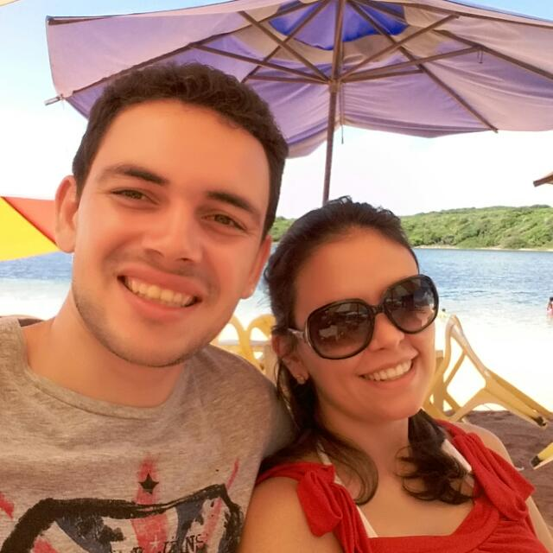
Hello!
We are:
Hugo
Map plotting and data cleaning
Paulo
Data collecting and processing
Tyrone
Idealizer, research and documenting

Slide 3

The great idea
What do we want to do?

Slide 4
Feeling analysis from twitter
Get a lot of tweets in a context
Analyze the content polarity
Plot it on a map divided by states

Slide 5

How to do this?
Which tools/libs did we use?

Slide 6
Python Libraries
TweePy
An easy-to-use Python library for accessing the Twitter API.
Folium
Folium makes it easy to visualize data that’s been manipulated in Python on an interactive leaflet map.
TextBlob
A Python library for processing textual data. It provides a simple API for into common natural language processing (NLP) tasks.
Shapely
Shapely is a BSD-licensed Python package for manipulation and analysis of planar geometric objects

Slide 7
Challenges?
Tweet doesn’t provides a nice geolocation
Google translate API rate limit
Choose the search key

Slide 8

Results

Slide 9
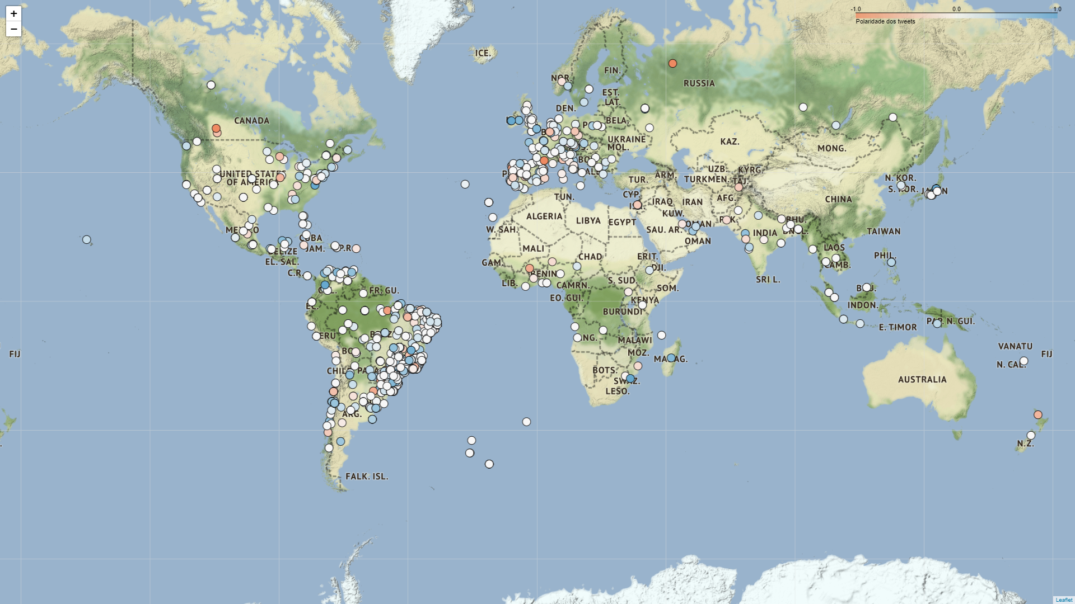

Circle markers
Bolsonaro
28/10/2018 09:00 BRT

Slide 10
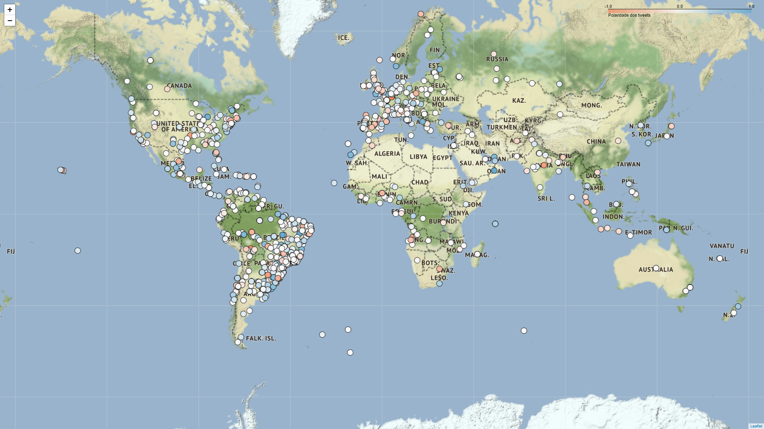
Circle markers
Bolsonaro
28/10/2018 20:00 BRT

Slide 11
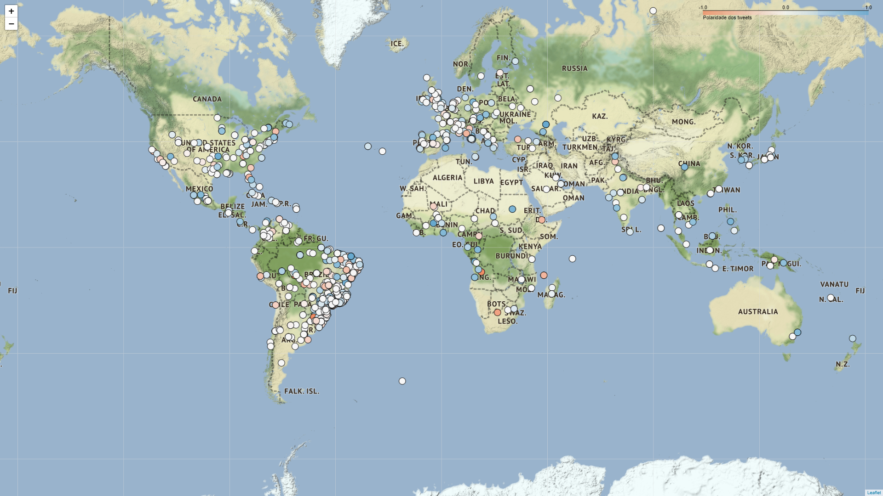
Circle markers
Haddad
28/10/2018 09:00 BRT

Slide 12

Circle markers
Haddad
28/10/2018 20:00 BRT

Slide 13
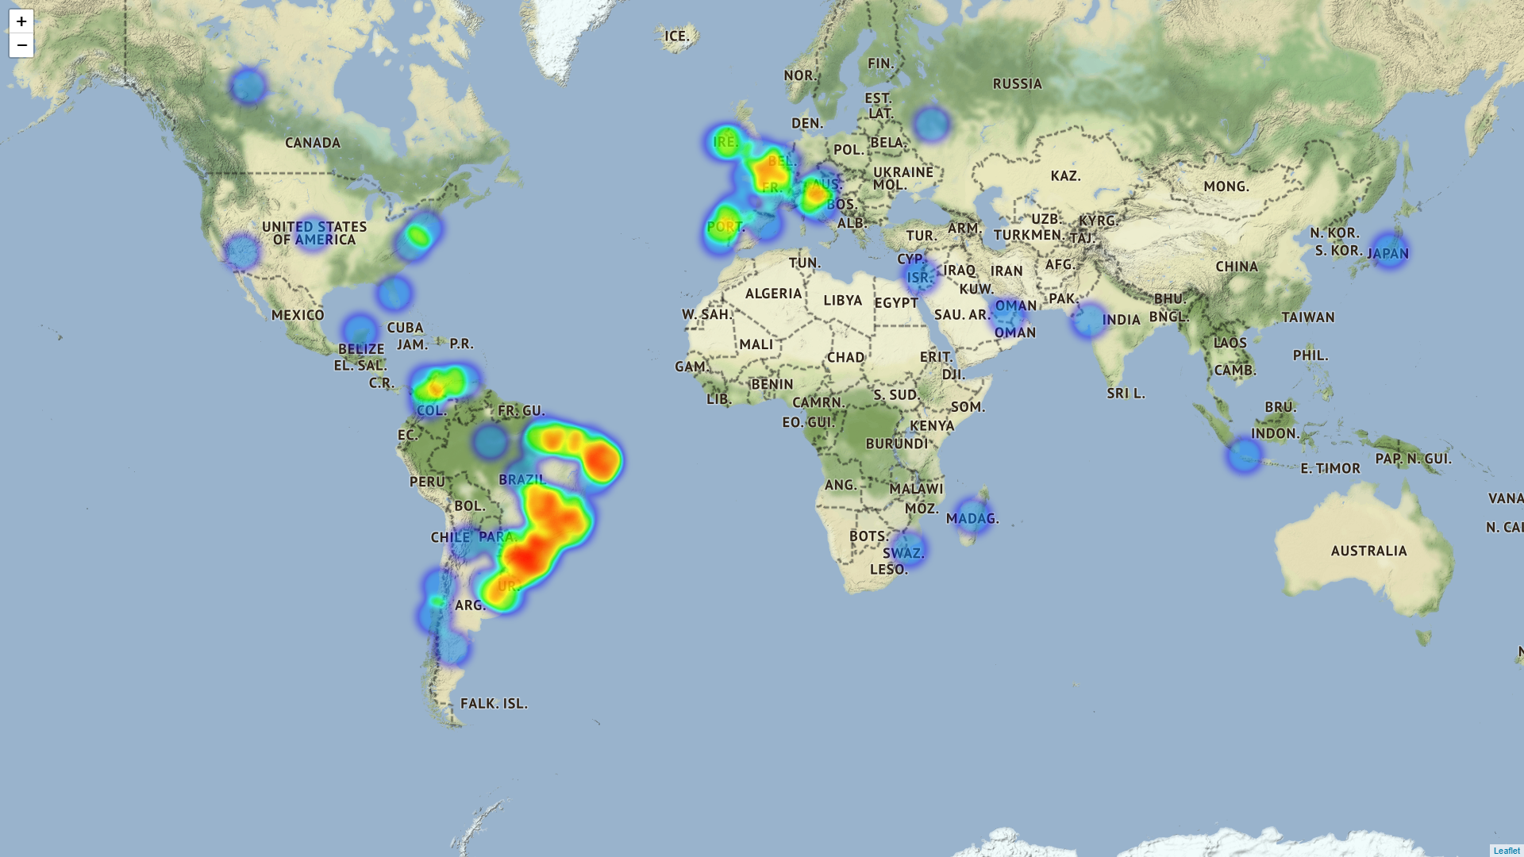
Heat map
Bolsonaro (polarity > 0.5)
28/10/2018 09:00 BRT

Slide 14
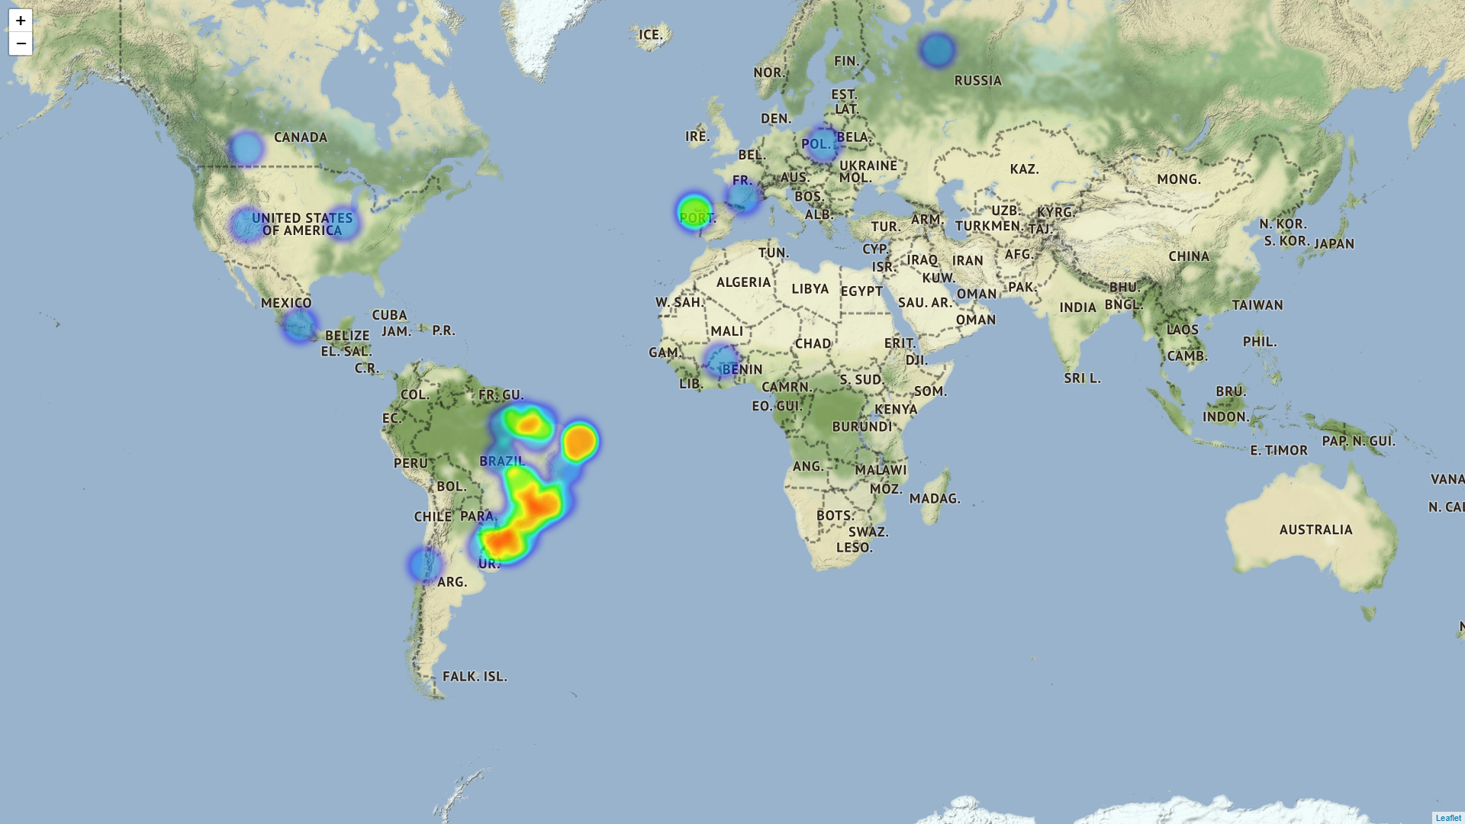
Heat map
Bolsonaro (polarity < -0.5)
28/10/2018 09:00 BRT

Slide 15
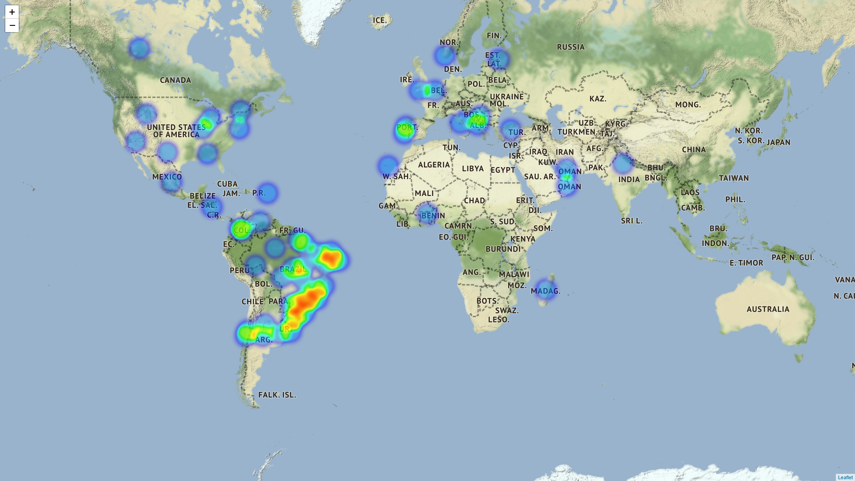
Heat map
Bolsonaro (polarity > 0.5)
28/10/2018 20:00 BRT

Slide 16
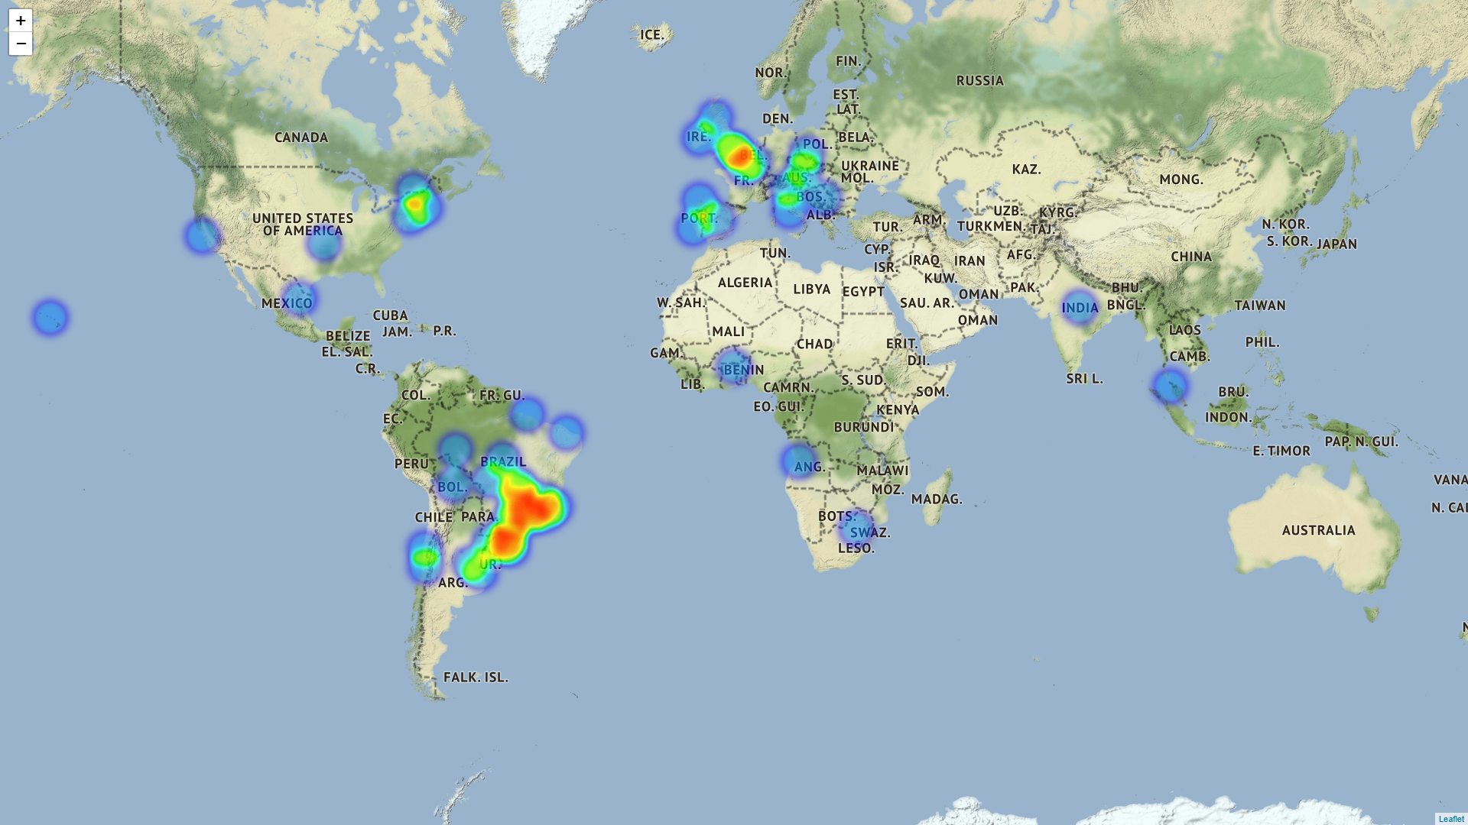
Heat map
Bolsonaro (polarity < -0.5)
28/10/2018 20:00 BRT

Slide 17
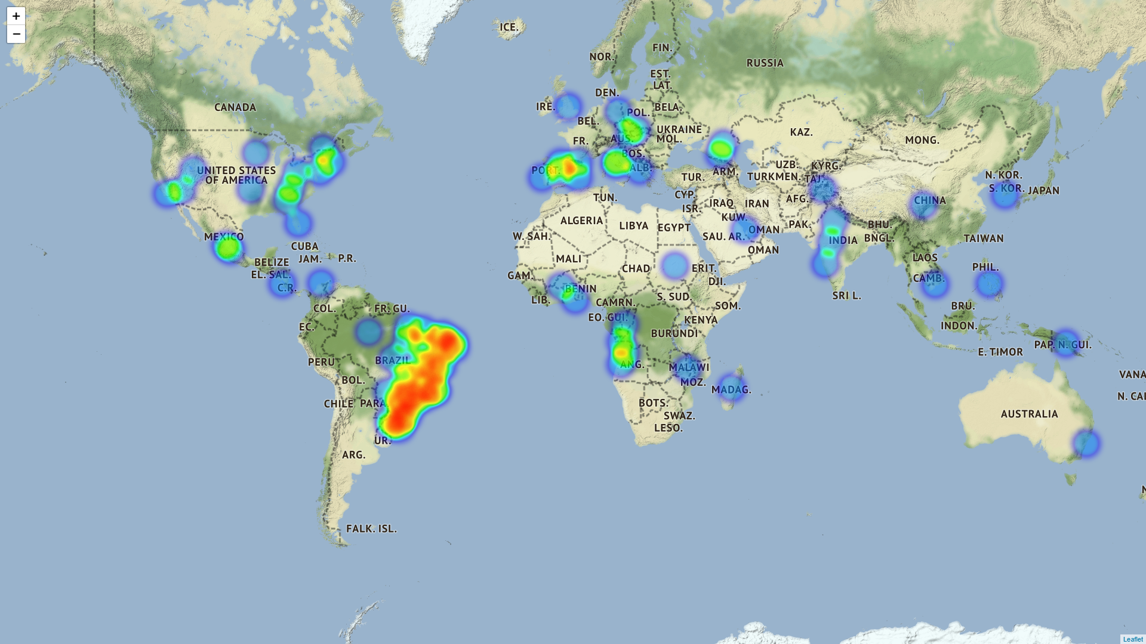
Heat map
Haddad (polarity > 0.5)
28/10/2018 09:00 BRT

Slide 18
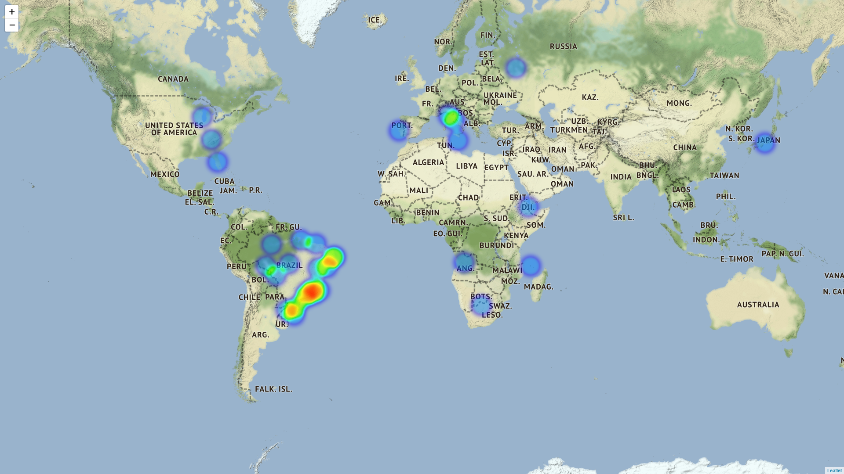
Heat map
Haddad (polarity < -0.5)
28/10/2018 09:00 BRT

Slide 19
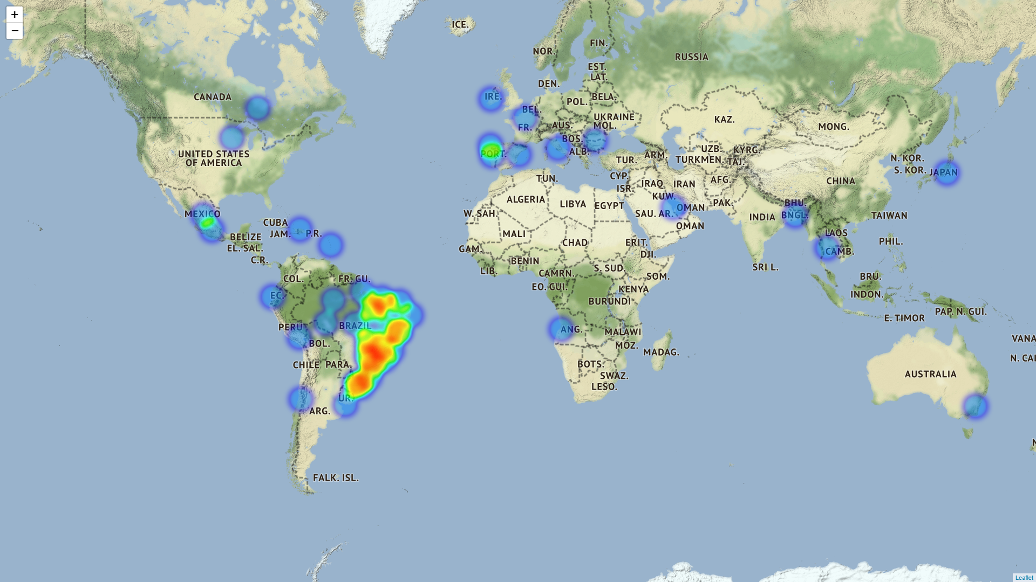
Heat map
Haddad (polarity > 0.5)
28/10/2018 20:00 BRT

Slide 20
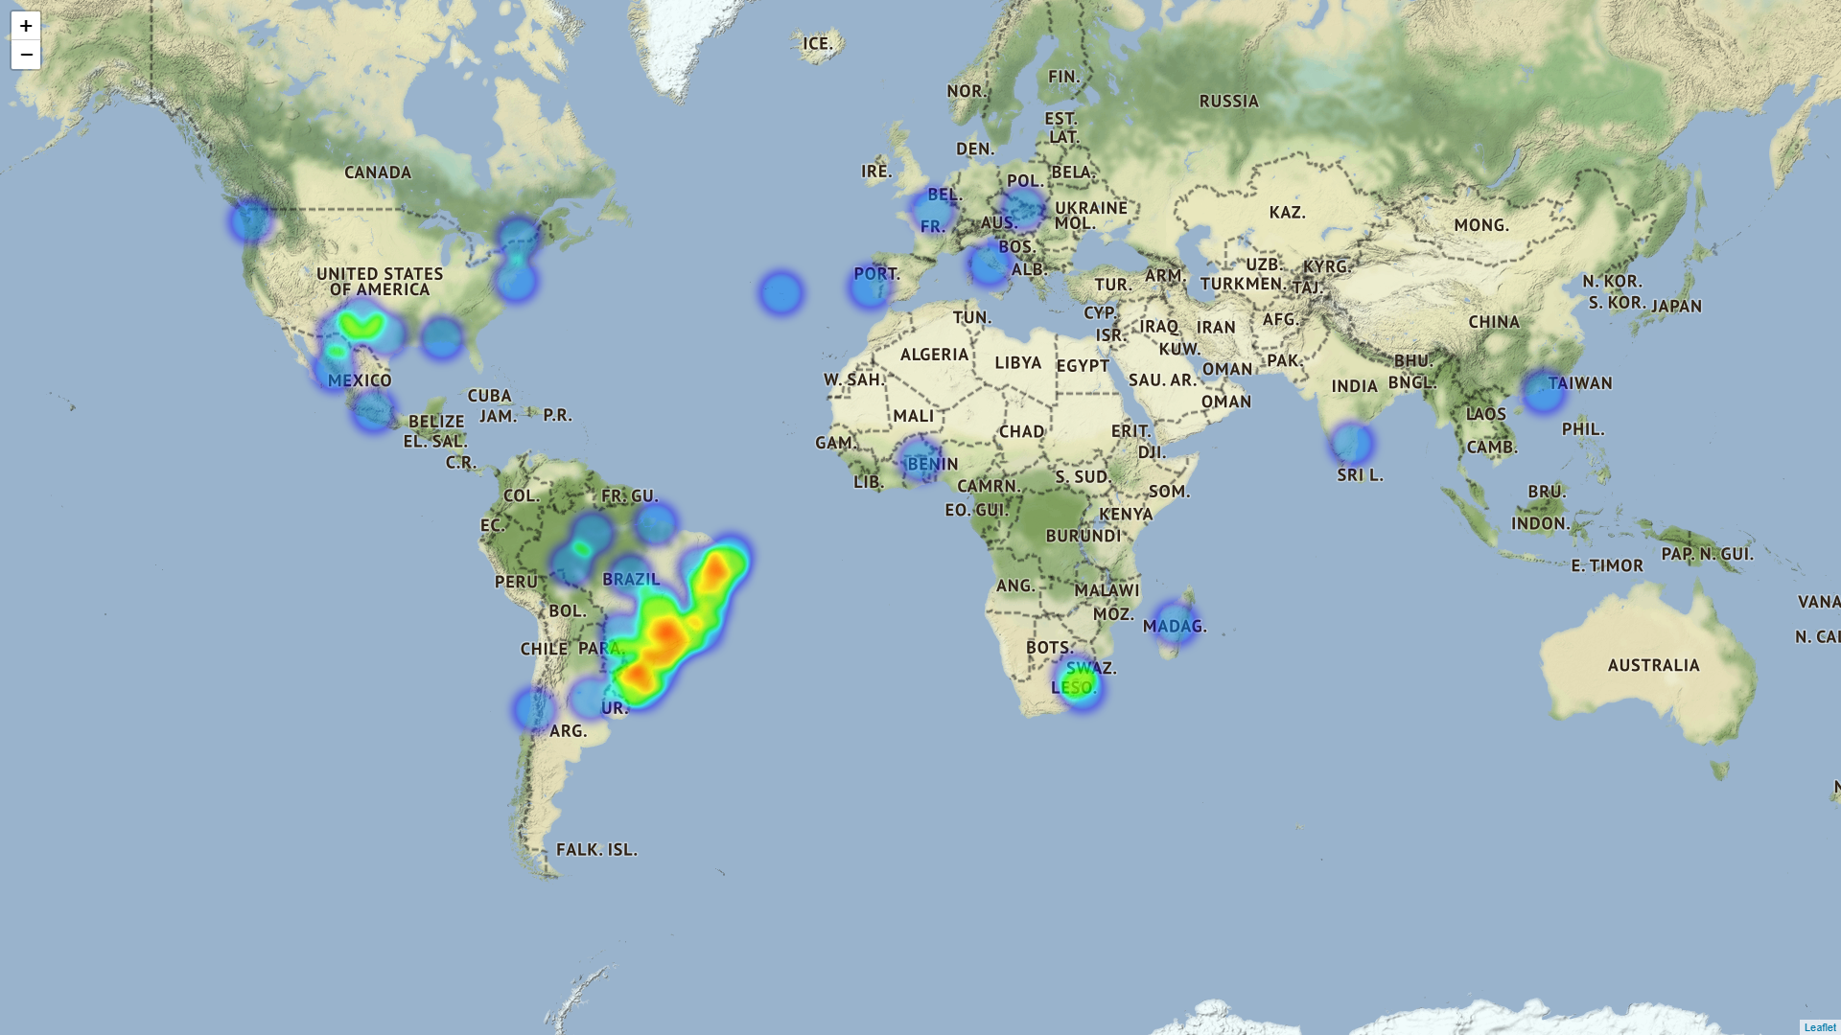
Heat map
Haddad (polarity < -0.5)
28/10/2018 20:00 BRT

Slide 21
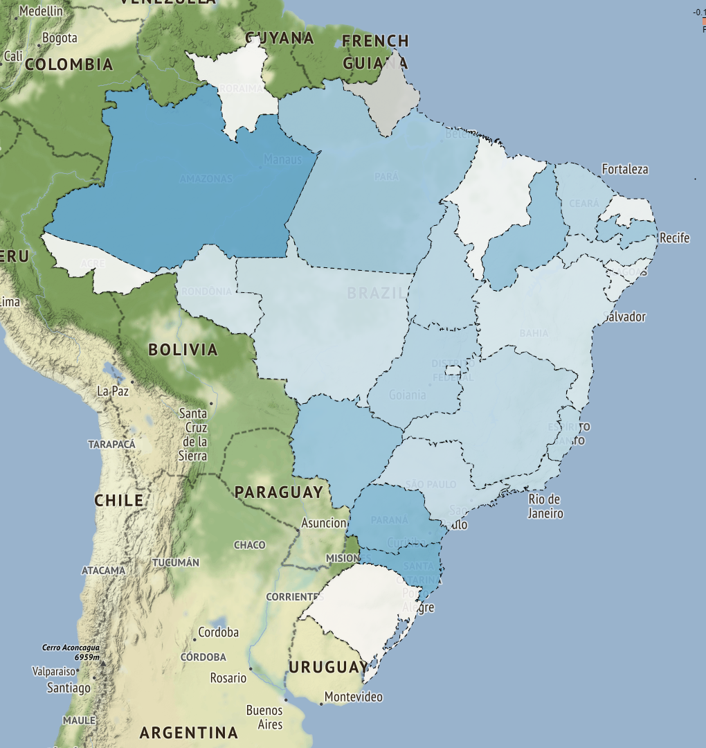
Choropleth map
Bolsonaro
 | count | max | mean | min
AC | 1 | 0 | 0 | 0
AL | 10 | 0.433333 | 0.0241667 | -0.125
AP | 0 | 0 | 0 | 0
AM | 19 | 1 | 0.180263 | -0.2
BA | 58 | 0.5 | 0.042665 | -1
CE | 35 | 0.953333 | 0.0790238 | -0.4
DF | 43 | 1 | 0.0424154 | -0.6
ES | 32 | 1 | 0.0728385 | -1
GO | 27 | 1 | 0.0862875 | -0.8
MA | 24 | 1 | 0.00825216 | -0.6
MT | 201 | 1 | 0.0517628 | -1
MS | 12 | 0.466667 | 0.118862 | -0.164062
MG | 119 | 0.9 | 0.0697856 | -0.8
PR | 71 | 0.875 | 0.144539 | -0.5
PB | 13 | 1 | 0.109118 | -0.5625
PA | 28 | 0.8 | 0.105891 | -0.8
PE | 57 | 1 | 0.0585709 | -0.607292
PI | 5 | 0.8 | 0.12 | -0.2
RN | 20 | 1 | 0.013836 | -0.529167
RS | 59 | 0.8 | -0.00481235 | -1
RJ | 233 | 1 | 0.0649297 | -1
RO | 5 | 0.199594 | 0.0415855 | -0.1
RR | 1 | 0 | 0 | 0
SC | 44 | 1 | 0.160511 | -0.8
SE | 13 | 0.8 | 0.0266026 | -0.4
SP | 300 | 1 | 0.062114 | -1
TO | 3 | 0.136364 | 0.0787879 | 0
Exterior | 698 | 1 | 0.0805059 | -1
28/10/2018 09:00 BRT

Slide 22
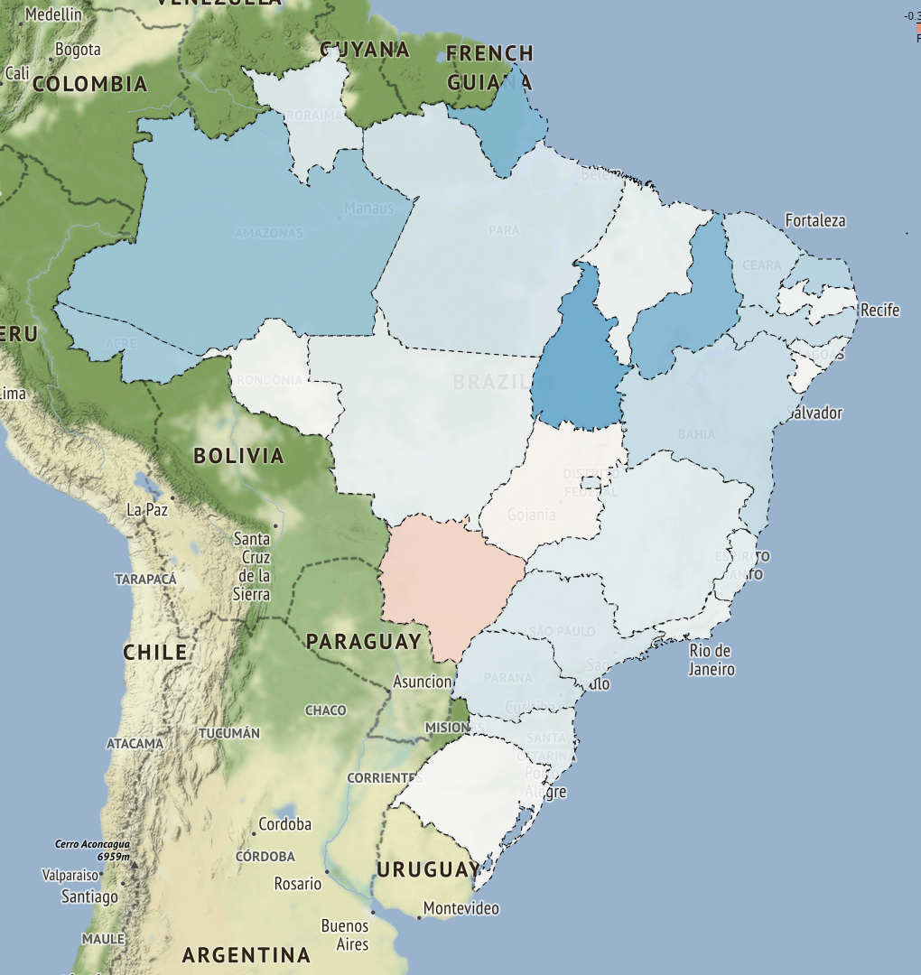
Choropleth map
Bolsonaro
 | count | max | mean | min
AC | 5 | 0.8 | 0.1675 | 0
AL | 7 | 0.5875 | 0.0400974 | -0.5
AP | 2 | 0.7 | 0.25 | -0.2
AM | 15 | 0.8 | 0.186558 | 0
BA | 20 | 1 | 0.102798 | -0.4
CE | 20 | 0.8 | 0.0999621 | -0.6
DF | 34 | 0.5 | 0.0621771 | -0.3125
ES | 33 | 0.5 | 0.0315242 | -0.66276
GO | 34 | 0.8 | -0.00672852 | -1
MA | 10 | 0.5 | 0.0230114 | -0.25
MT | 96 | 1 | 0.0254142 | -1
MS | 5 | 0.0222222 | -0.0955556 | -0.5
MG | 128 | 0.8 | 0.0369227 | -1
PR | 69 | 1 | 0.0615829 | -1
PB | 10 | 0.25 | 0.0125 | -0.125
PA | 18 | 0.8 | 0.0641655 | -1
PE | 41 | 0.8 | 0.11005 | -0.4
PI | 6 | 1 | 0.250397 | -0.0833333
RN | 16 | 0.8 | 0.141667 | -0.4
RS | 125 | 1 | 0.00418082 | -0.9
RJ | 282 | 1 | 0.0222982 | -1
RO | 11 | 0.5 | 5.04647e-18 | -0.6
RR | 6 | 0.342857 | 0.0446429 | -0.1
SC | 56 | 1 | 0.0357175 | -1
SE | 3 | 0 | -0.00333333 | -0.01
SP | 218 | 1 | 0.0555679 | -1
TO | 5 | 1 | 0.307273 | 0
Exterior | 939 | 1 | 0.056617 | -1
28/10/2018 20:00 BRT

Slide 23
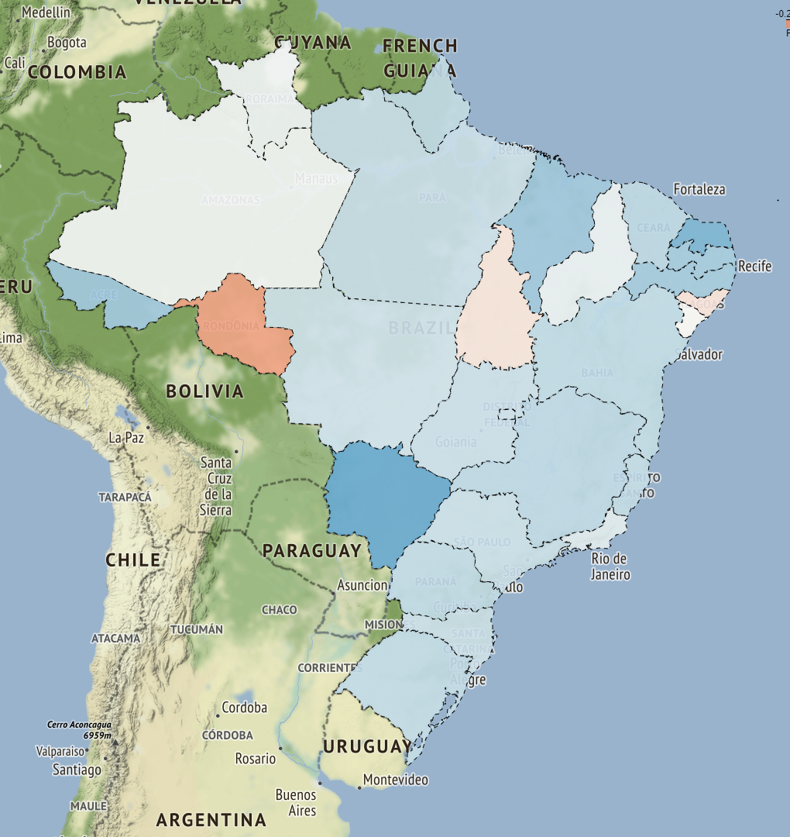
Choropleth map
Haddad
 | count | max | mean | min
AC | 4 | 0.5 | 0.165625 | 0
AL | 6 | 0.25 | -0.0541667 | -0.25
AP | 6 | 0.5 | 0.105208 | -0.075
AM | 29 | 0.9 | 0.00502874 | -0.8
BA | 55 | 0.925 | 0.106802 | -1
CE | 40 | 1 | 0.120077 | -0.5
DF | 45 | 0.75 | 0.0831282 | -0.5
ES | 36 | 1 | 0.106372 | -0.6
GO | 31 | 0.8 | 0.0869048 | -0.5
MA | 27 | 0.875 | 0.172434 | -0.55
MT | 177 | 1 | 0.0782487 | -1
MS | 9 | 0.75 | 0.280556 | -0.1
MG | 136 | 1 | 0.111188 | -0.8
PR | 53 | 0.7 | 0.106474 | -1
PB | 17 | 1 | 0.16313 | -0.1
PA | 27 | 0.8 | 0.0866623 | -0.714286
PE | 85 | 1 | 0.164127 | -0.75
PI | 15 | 0.75 | 0.027619 | -0.5
RN | 22 | 0.85 | 0.243479 | -0.5
RS | 92 | 1 | 0.105256 | -1
RJ | 224 | 1 | 0.0482036 | -1
RO | 7 | 0.492857 | -0.215306 | -1
RR | 4 | 0.05 | 0.0125 | 0
SC | 38 | 0.85 | 0.0850721 | -0.6
SE | 8 | 0.5 | 0 | -1
SP | 315 | 1 | 0.0886601 | -1
TO | 6 | 0.1875 | -0.05 | -0.3
Exterior | 558 | 1 | 0.100731 | -1
28/10/2018 09:00 BRT

Slide 24
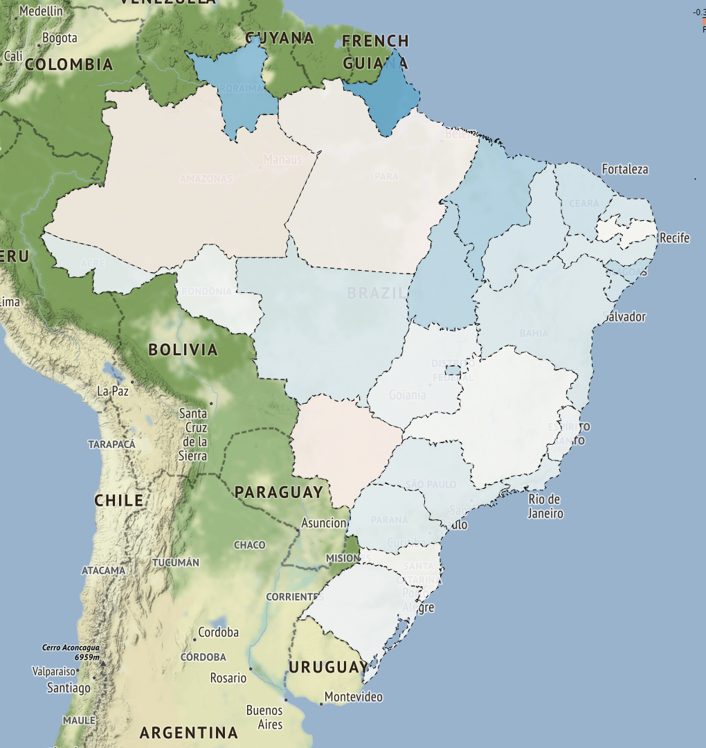
Choropleth map
Haddad
 | count | max | mean | min
AC | 3 | 0.1 | 0.0333333 | 0
AL | 11 | 0.5 | 0.122297 | -0.6
AP | 5 | 1 | 0.327273 | 0
AM | 13 | 1 | -0.0329545 | -0.6
BA | 57 | 0.8 | 0.0588462 | -0.9
CE | 34 | 1 | 0.0886029 | -0.5
DF | 47 | 0.9 | 0.112373 | -1
ES | 33 | 1 | 0.021158 | -0.6
GO | 32 | 0.6 | 0.0215732 | -0.8
MA | 21 | 1 | 0.159921 | -0.466667
MT | 200 | 1 | 0.0594762 | -1
MS | 22 | 0.5 | -0.0346681 | -0.7
MG | 120 | 1 | 0.00586735 | -0.714286
PR | 82 | 0.8 | 0.0456716 | -0.7
PB | 21 | 0.5 | 0.000992063 | -0.6
PA | 31 | 0.55 | -0.0193548 | -0.75
PE | 52 | 0.7 | 0.0524444 | -0.7
PI | 11 | 0.58 | 0.0701515 | -0.166667
RN | 12 | 0.5 | 0.0666667 | 0
RS | 99 | 1 | 0.0224213 | -1
RJ | 221 | 1 | 0.0483724 | -1
RO | 9 | 0.8 | 0.00960648 | -0.651042
RR | 2 | 0.5 | 0.25 | 0
SC | 73 | 0.8 | -0.00396033 | -0.8
SE | 10 | 0.5 | 0.0795313 | 0
SP | 362 | 1 | 0.046055 | -1
TO | 6 | 0.8 | 0.1375 | 0
Exterior | 483 | 1 | 0.0321382 | -1
28/10/2018 20:00 BRT

Slide 25
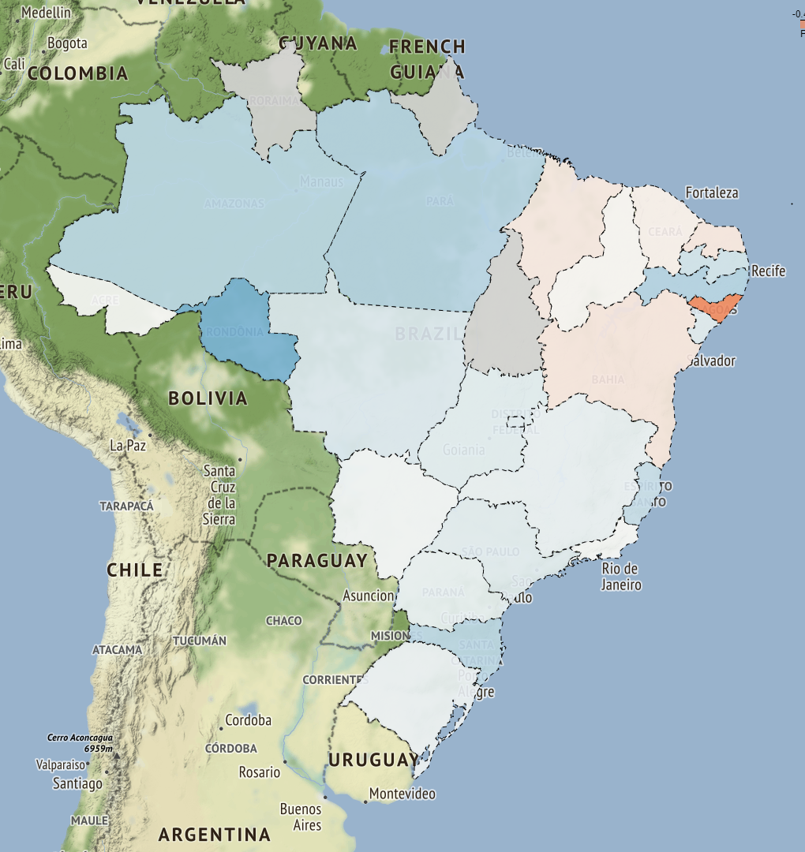
Choropleth map (extra)
Bolsonaro
 | count | max | mean | min
AC | 1 | 0 | 0 | 0
AL | 2 | 0 | -0.4 | -0.8
AP | 0 | 0 | 0 | 0
AM | 4 | 0.5 | 0.161111 | 0
BA | 18 | 0.6 | -0.0642196 | -0.8
CE | 15 | 0.525 | -0.0318316 | -0.566667
DF | 18 | 0.5 | 0.0648148 | -0.2
ES | 5 | 0.6 | 0.133333 | -0.266667
GO | 10 | 0.675 | 0.0610714 | -0.5
MA | 6 | 0.35 | -0.0583333 | -0.7
MT | 95 | 1 | 0.0797227 | -1
MS | 7 | 0.0777778 | 0.018254 | 0
MG | 54 | 0.9 | 0.0386893 | -0.714286
PR | 24 | 1 | 0.0420646 | -0.6
PB | 10 | 0.5 | 0.110937 | -0.390625
PA | 11 | 1 | 0.17914 | -0.714286
PE | 21 | 0.91 | 0.190483 | -0.361905
PI | 3 | 0.375 | -0.00833333 | -0.6
RN | 5 | 0 | -0.06 | -0.3
RS | 24 | 0.625 | 0.0375836 | -0.8
RJ | 79 | 1 | 0.00677212 | -1
RO | 2 | 0.7 | 0.35 | 0
RR | 0 | 0 | 0 | 0
SC | 13 | 0.565625 | 0.163931 | -0.1
SE | 5 | 0.357143 | 0.0714286 | 0
SP | 104 | 0.8 | 0.0624893 | -0.7
TO | 0 | 0 | 0 | 0
Exterior | 173 | 1 | 0.0276677 | -1
27/10/2018 10:00 BRT

Slide 26


Thanks!
Any questions?
You can find us at:
@hugoTHO
@lopespaulo
@tyronedamasceno
Repository

